Slide 1

Analysis on the National Rural Employment Guarantee Act (NREGA) Using Power BI
OLAYINKA OLAWALE VICTOR

Slide 2
PROBLEM STATEMENT
NREGA is a vital initiative to alleviate rural unemployment and poverty. This project analyzes NREGA data to evaluate its effectiveness, regional disparities, budget utilization, and factors affecting completion. The dataset includes various parameters like job cards, workforce, and expenditure. Through data analytics, insights will guide policymakers for scheme optimization.

Slide 3
PROJECT OBJECTIVES
● Exploratory data analysis (EDA) to identify patterns, trends, and disparities in NREGA implementation.
● Utilizing data visualization techniques to present key findings effectively.
● Drawing actionable insights to inform policymakers and administrators about the strengths and weaknesses of the NREGA program

Slide 4
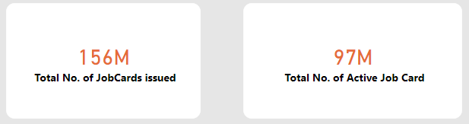
JOB CARDS

Slide 5
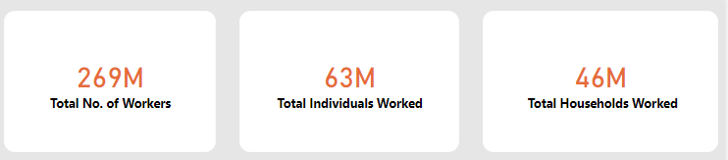
JOB OPPORTUNITIES

Slide 6
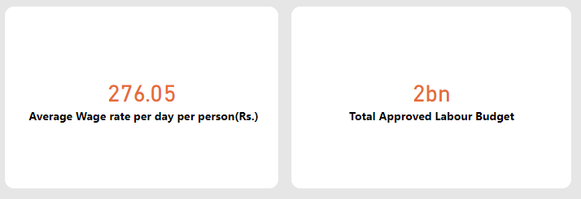
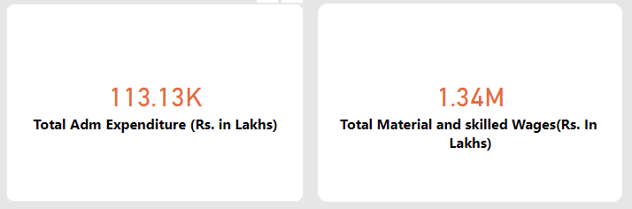
Wage and Budget

Slide 7
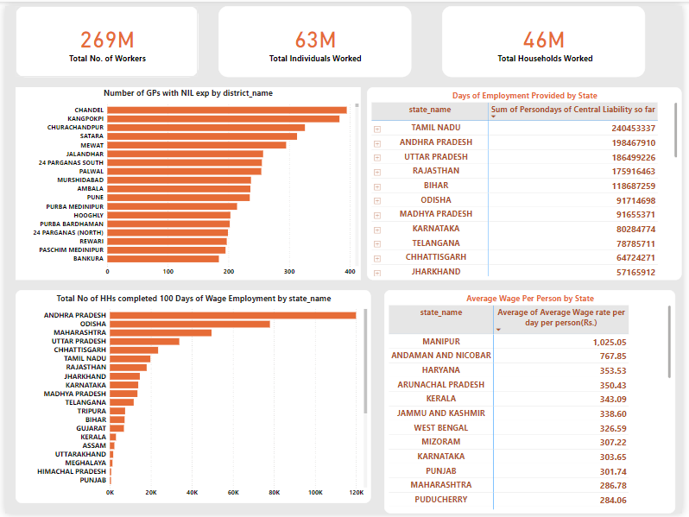

Slide 8
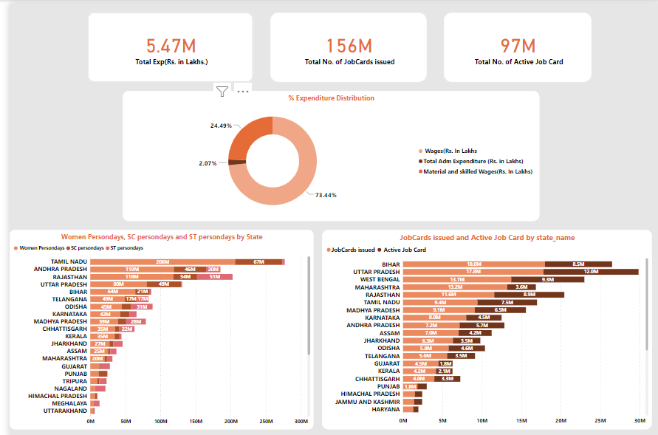

Slide 9
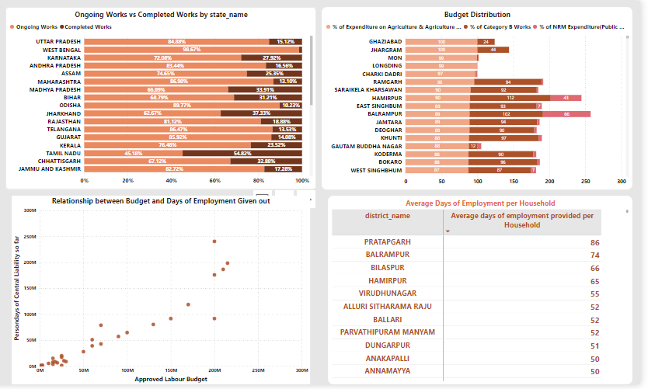

Slide 10
CONCLUSION
Employment Generation:
NREGA is effective in generating substantial employment opportunities in certain states, but there are significant regional disparities that need to be addressed to ensure uniform effectiveness across all states.
Budget Utilization:
There is a strong correlation between budget allocation and employment generation. Effective utilization of the budget is crucial for maximizing employment opportunities.
Project Completion:
Delays in the completion of works are evident in several states. Efficient project management and monitoring are essential to improve completion rates.
Inclusivity:
Efforts to include women, SC, and ST workers are visible in certain states. However, more focus is needed to ensure uniform inclusivity across all regions.
Engagement Level:
States with a high number of issued and active job cards, such as Bihar and Uttar Pradesh, show high engagement and likely effectiveness of NREGA in providing employment opportunities.

Slide 11
RECOMENDATIONS
Address Regional Disparities:
Implement targeted interventions in states with lower employment generation and budget utilization. Share best practices from high-performing states like Tamil Nadu and Andhra Pradesh.
Enhance Project Management:
Improve monitoring and evaluation mechanisms to ensure timely completion of ongoing works. Implement project management training for local administrators.
Optimize Budget Utilization:
Conduct regular audits and reviews to ensure efficient utilization of allocated budgets. Focus on reducing administrative and material costs where possible.
Promote Inclusivity:
Strengthen policies and incentives to increase participation of women, SC, ST, and differently abled workers. Monitor demographic data closely to ensure inclusivity targets are met.

Slide 12
THANK YOU FOR WATCHING

